Slide 1
CS 4530 Software Engineering
Lecture 9.1: Why Engineer Distributed Software?
Jonathan Bell, Adeel Bhutta, Ferdinand Vesely, Mitch Wand
Khoury College of Computer Sciences
© 2022, released under CC BY-SA
Notes:
HI, THIS is professor bell. In this lesson, we’ll learn the what’s and the why’s of creating distributed software

Slide 2
Learning Objectives for this Lesson
By the end of this lesson, you should be able to…
Describe 5 key goals of distributed systems
Describe 8 key common fallacies of distributed systems
Analyze a system’s requirements and determine if it should be implemented as a distributed system or not

Slide 3





What is a distributed system?
Model:
Many servers talking through a network
Model:
Many servers and clients talking through a network
Notes:
First: some ground rules. What is a distributed system? Most apps that we work with are distributed in some way, at least in the sense that there is some code that runs in a client, and elsewhere on a server. For this and the following lesson, however, we’ll focus on two particular distributed systems models: where we are focusing on the SERVER aspects, and distributed the server code across multiple computers, with a network between them

Slide 4
Why expand to distributed systems?
Scalability
Performance
Latency
Availability
Fault Tolerance
“Distributed Systems for Fun and Profit”, Takada
Notes:
scale in size (more nodes), geographic (reduce time to respond to users), administration (administrators per machine)

Slide 5
Distributed Systems Goals
“the ability of a system, network, or process, to handle a growing amount of work in a capable manner or its ability to be enlarged to accommodate that growth.”
Scalability
Performance
Latency
Availability
Fault Tolerance
“Distributed Systems for Fun and Profit”, Takada
Notes:
Most things are easy to do small: Let’s make a system that lets 5 people run around a 2D map. Great! How do we let 100,000 people run around that same map? Uh-oh. A scalable system is one in which adding more work (more usage) does not make things incrementally worse: We want to be able to increase the capacity and usage of our service without it slowing to a halt.

Slide 6
Distributed Systems Goals
“is characterized by the amount of useful work accomplished by a computer system compared to the time and resources used.”
Scalability
Performance
Latency
Availability
Fault Tolerance
“Distributed Systems for Fun and Profit”, Takada
Notes:
measured perhaps by throughput, utilization of resources, response time (see latency)

Slide 7
Distributed Systems Goals
“The state of being latent; delay, a period between the initiation of something and the it becoming visible.”
Scalability
Performance
Latency
Availability
Fault Tolerance
“Distributed Systems for Fun and Profit”, Takada
Notes:
pesky limits: speed of light, RAM/hard drives/CPUs. but for distributed systems can come in much more

Slide 8
Distributed Systems Goals
“the proportion of time a system is in a functioning condition. If a user cannot access the system, it is said to be unavailable.”
Scalability
Performance
Latency
Availability
Fault Tolerance
Availability = uptime / (uptime + downtime).
Often measured in “nines”
Availability % | Downtime/year
90% | >1 month
99% | < 4 days
99.9% | < 9 hours
99.99% | <1 hour
99.999% | 5 minutes
99.9999% | 31 seconds
“Distributed Systems for Fun and Profit”, Takada
Notes:
hard to handle availability on a single machine. because we want redundancy. CLICK to show table we want to take a bunch of unreliable components and build a bigger thing that itself is reliable. what are the components and what kinds of redundancy can we provide?
Availability considers things more broadly than uptime though: what if there is a network outage? Without knowing every possible thing that can fail, instead, we might design for fault tolerance

Slide 9
Distributed Systems Goals
“ability of a system to behave in a well-defined manner once faults occur”
Scalability
Performance
Latency
Availability
Fault Tolerance
What kind of faults?
Disks fail
Networking fails
Power supplies fail
Security breached
Datacenter goes offline
Power goes out
“Distributed Systems for Fun and Profit”, Takada
Notes:
Which is to say: can we define a set of faults that we expect, and then design a system to tolerate them? We concede that we can’t tolerate all faults. If nothing else, our service might degrade in availability if our business goes bankrupt!

Slide 10
Distributed Systems Challenges
More machines, more problems
Say there’s a 1% chance of having some hardware failure occur to a machine (power supply burns out, hard disk crashes, etc)
Now I have 10 machines
Probability(at least one fails) = 1 - Probability(no machine fails) = 1-(1-.01)¹⁰ = 10%
100 machines -> 63%
200 machines -> 87%
Notes:
Fault tolerance is a tricky beast, however.
So obviously just adding more machines doesn’t solve fault tolerance

Slide 11
Distributed Systems Challenges
Number of nodes + distance between them
Notes:
an increase in the number of independent nodes increases the probability of failure in a system (reducing availability and increasing administrative costs)
an increase in the number of independent nodes may increase the need for communication between nodes (reducing performance as scale increases)

Slide 12


Distributed Systems Challenges
Number of nodes + distance between them
SF
NY
Even if cross-city links are fast and cheap (are they?)
Still that pesky speed of light…
DC
LONDON
Notes:
an increase in geographic distance increases the minimum latency for communication between distant nodes (reducing performance for certain operations)

Slide 13
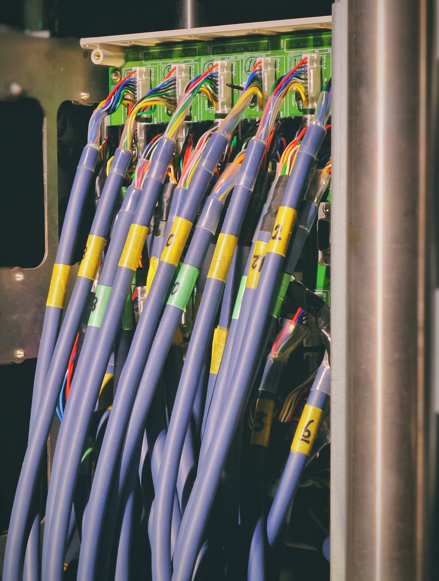
Distributed Systems Challenges
Networks are imperfect
The network may be:
Unreliable
Insecure
Slow
Expensive
Limited

Slide 14
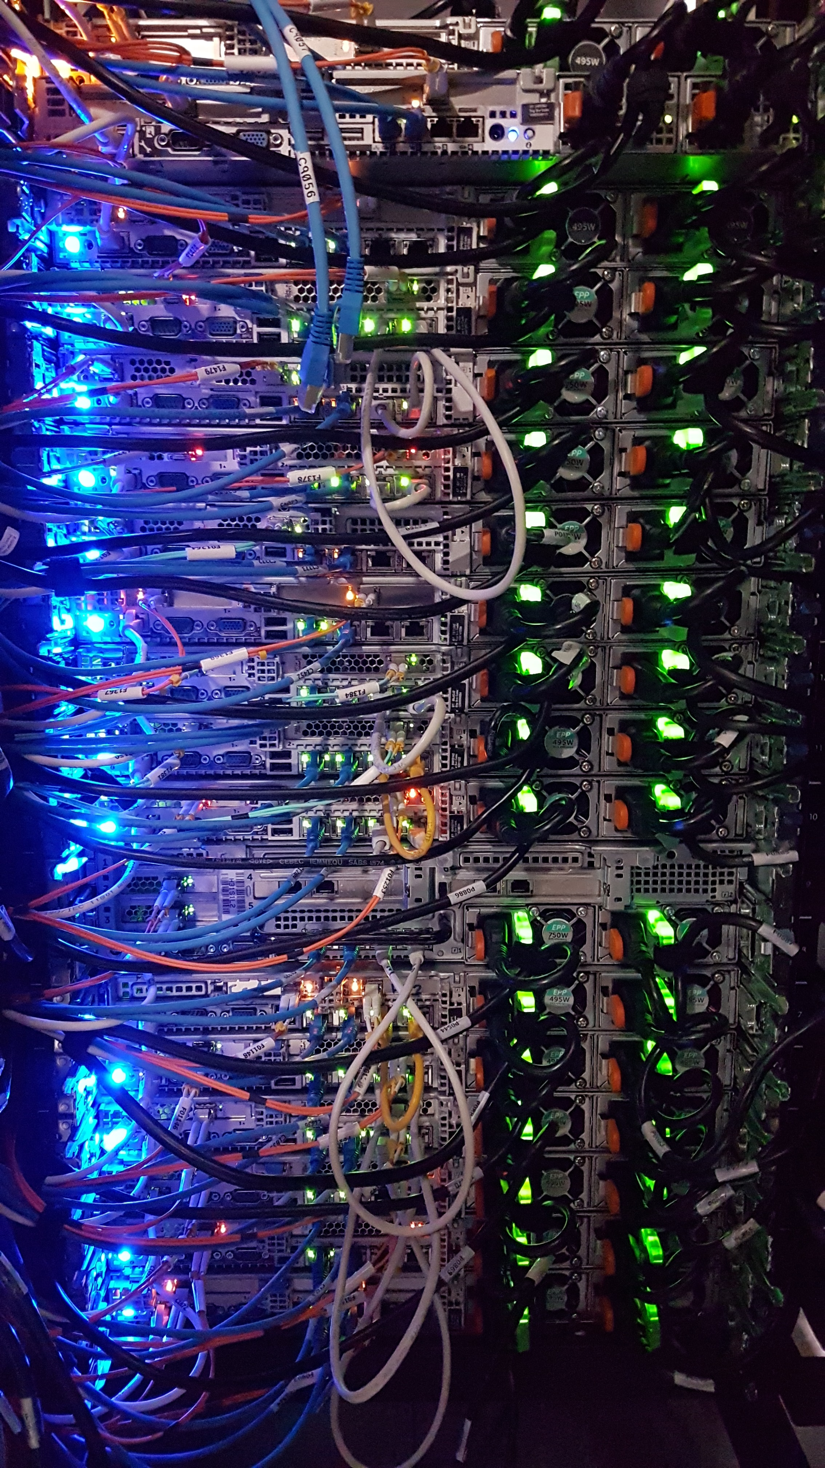
8 Fallacies of Distributed Computing
Sun Microsystems, early 1990’s
}
The network is reliable
Latency is zero
Bandwidth is infinite
The network is secure
Topology doesn't change
Transport cost is zero
The network is homogeneous
There is one administrator
Physical Properties of
networks
Notes:
In addition to these constraints that might make it challenging to achieve better performance, scale, or fault tolerance due to the location and number of machines, we also now are exposed to risks that come from the network itself. These so called 8 fallacies of distributed computing were outlined in the 90’s in white papers from sun Microsystems, and largely still hold. Most are tied to physical properties of networks themselves
“There is one administrator” - Might get away with this if you install your system on your own private network, doesn’t talk to anyone. But: what happens when you don’t, and then things go wrong? Example: Comcast maintains its own blocklist of domain names that could be malicious. What happens if your hosting provider ends up on that block list?

Slide 15

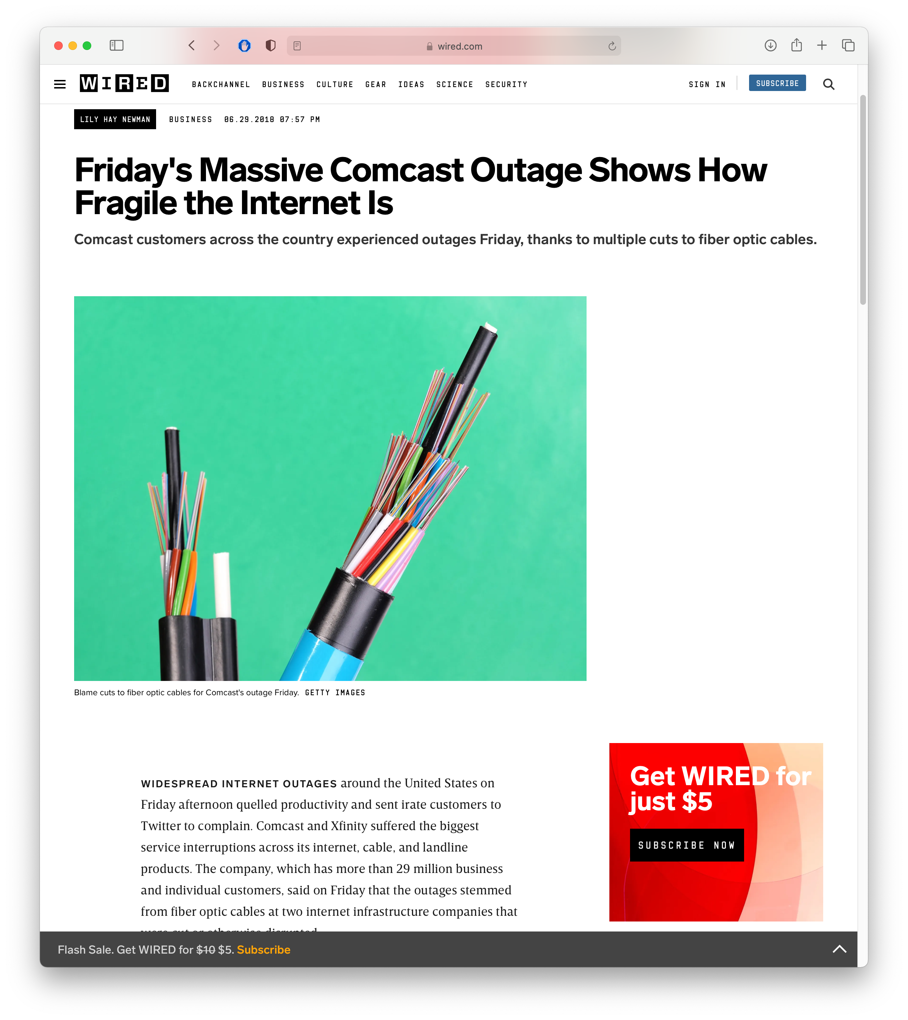
Do these fallacies still hold?
Networks still fail, intermittently and for prolonged periods

Slide 16
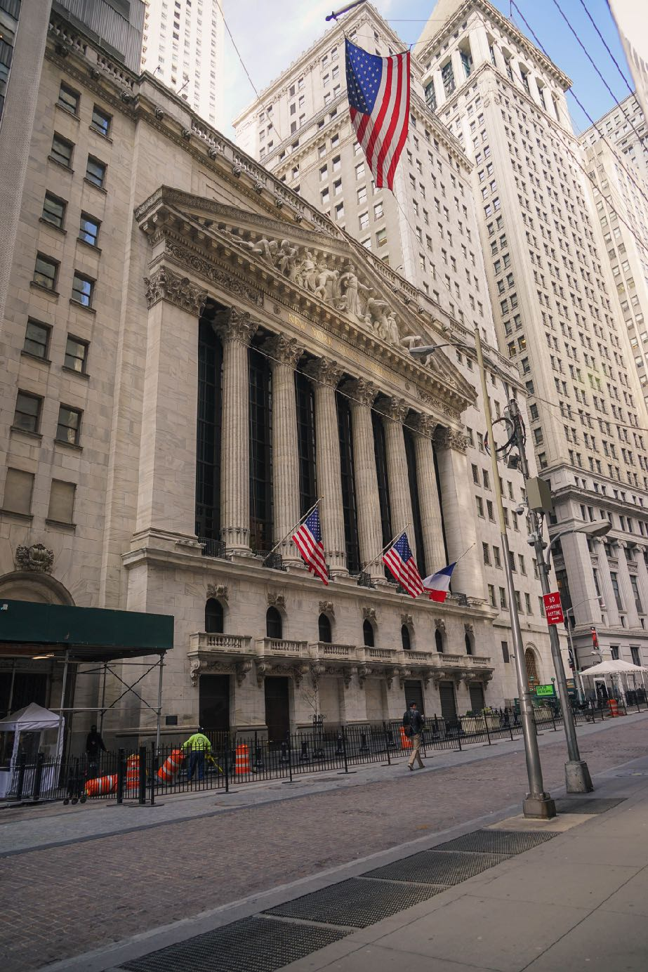
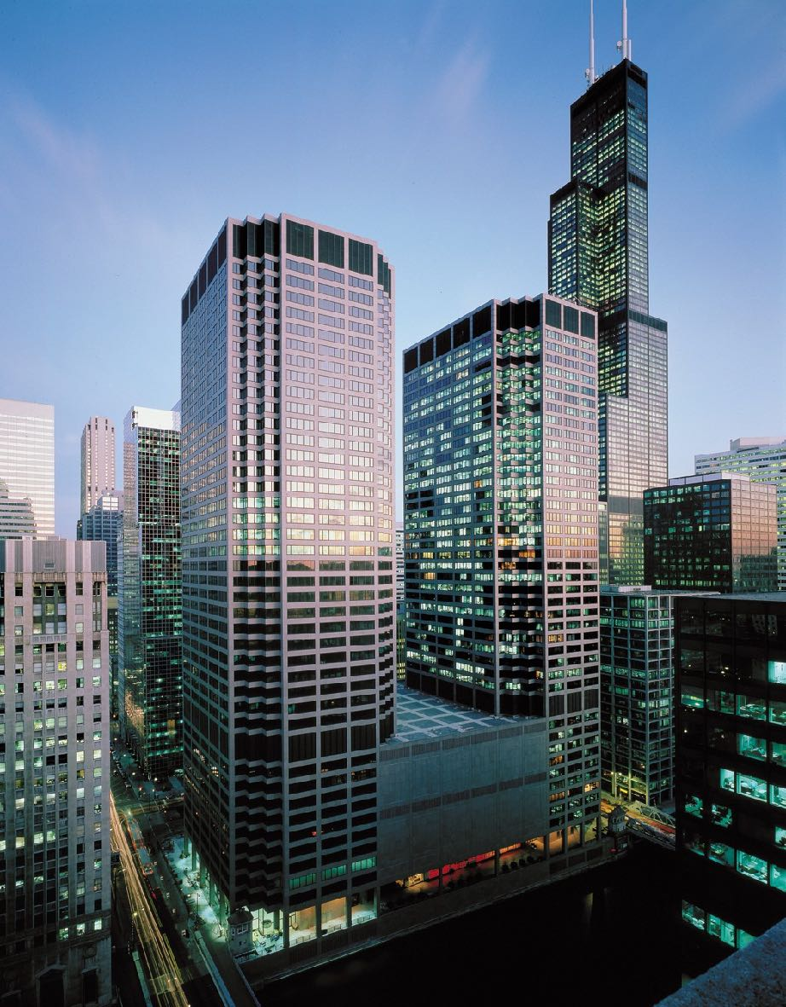


Do these fallacies still hold?
We haven’t beaten the speed of light yet.
~700 miles
Round trip: ~14 msec @ speed of light
3Ghz CPU would process ~22m instructions in this time!
Equinix NY5 Data Center, Secaucus NJ
CME Data Center, Aurora, IL
Chicago Mercantile Exchange, Chicago, IL
NY Stock Exchange, New York, NY
Photos:
CME Building: By CME Group/Henry Delforn/Allan Schoenberg - CME Group, CC BY-SA 3.0
NYSE Building: By Jeffrey Zeldman, CC BY 2.0
CME data center: by CME Group
NY5 data center: by Equinix Inc
Notes:
People actually care a LOT about the latency between NYC and Chicago, because commodities are traded in Chicago and stocks are traded in NYC
Changes to commodities prices (e.g. ethanol) can dramatically impact price of some stocks.
Note not really Chicago or NYC, data centers are 10-15 miles outside of city where land is cheaper. Secaucus NJ and Aurora IL
It’s not quite as simple as 700 miles -> 7.4msec
There are streams, mountains, etc… more like 1,000 miles
Light is refracted in a fiber optic cable is ~31% slower
What do we do if money is no object?

Slide 17
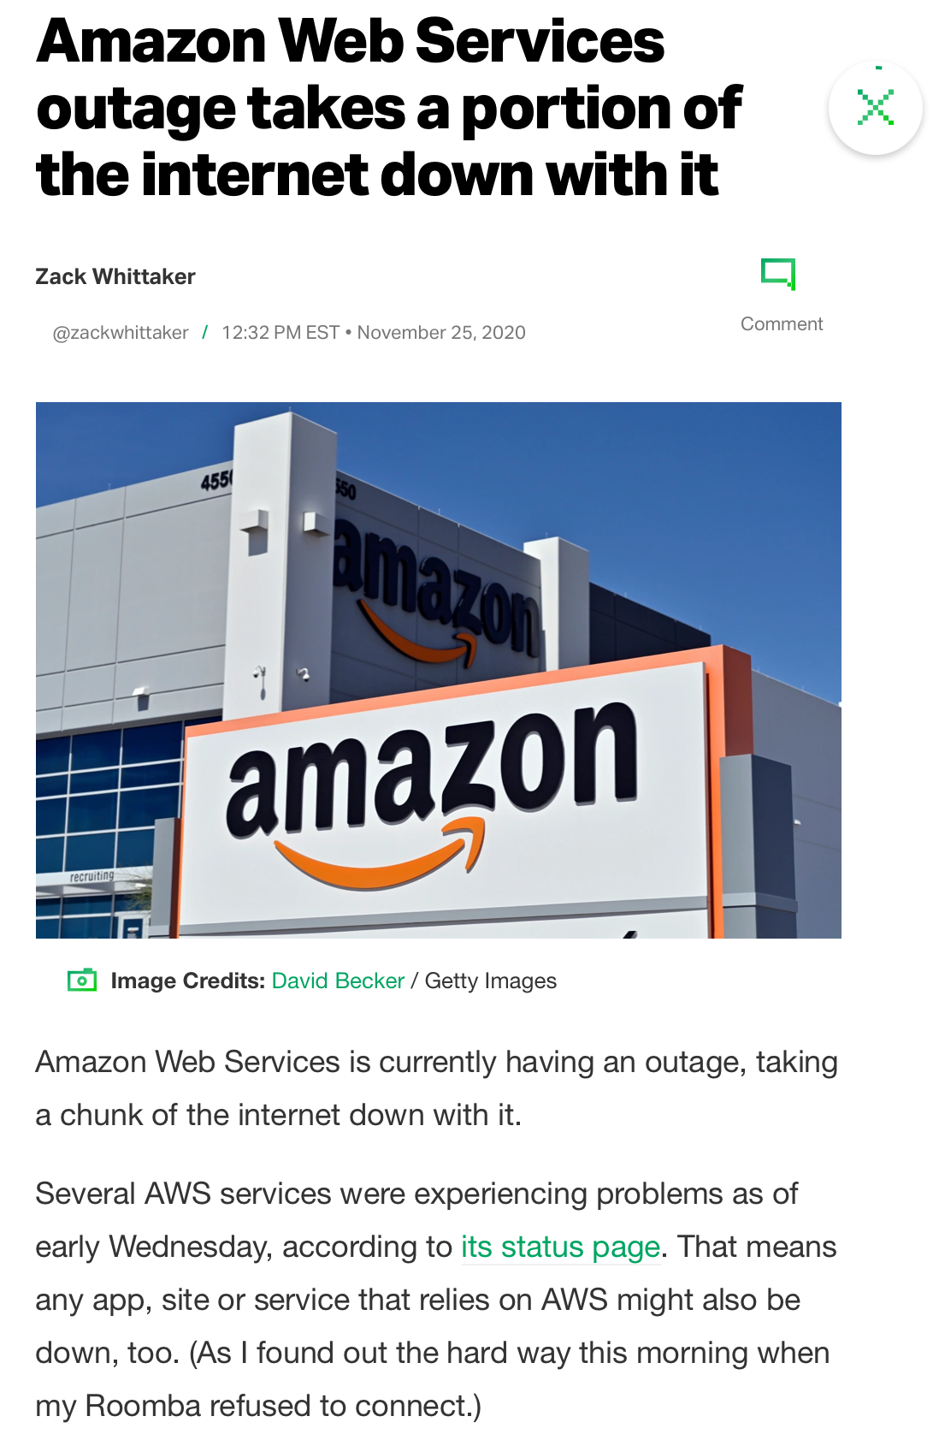
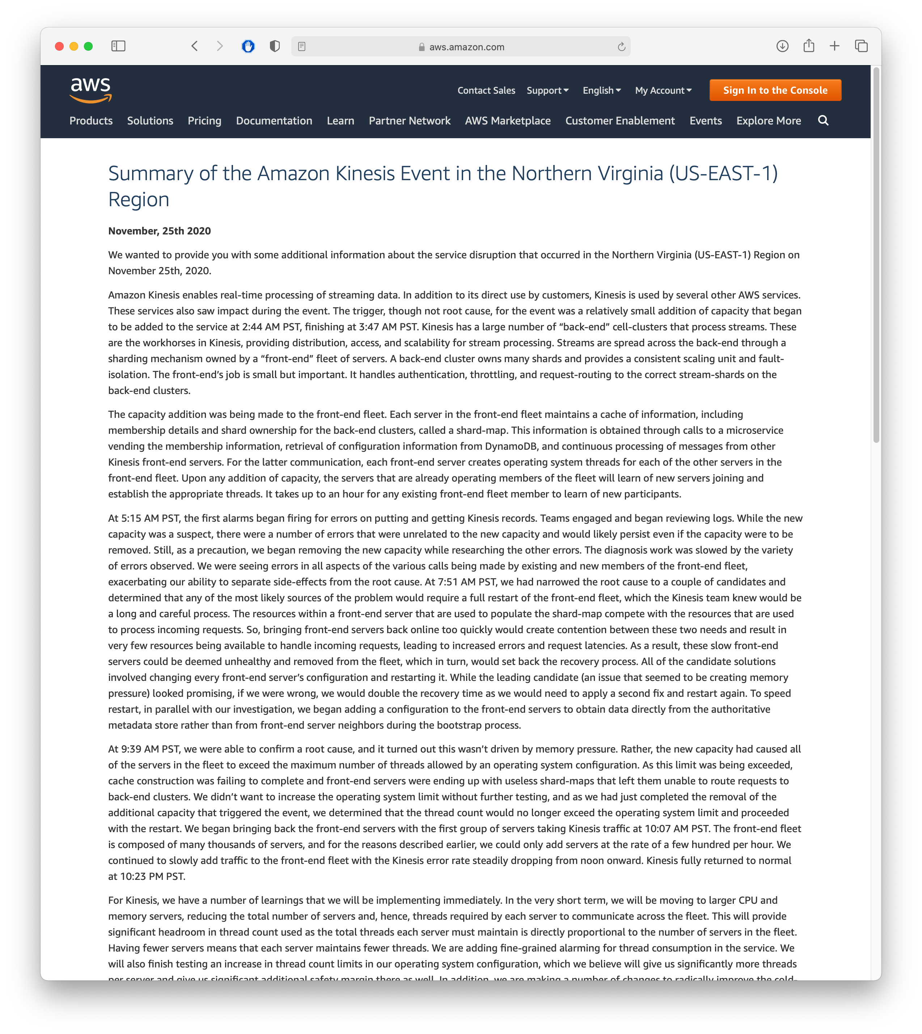
Do these fallacies still hold?
We still rely on other administrators, who are not infallible

Slide 18
Should we make {our software} distributed?
Reflecting on goals + challenges
Do we need to store more data than one computer can store?
Do we need to process requests faster than one computer can?
Are we willing and able to take on these additional complications?
Next lesson: what tools do we have at our disposal?

Slide 19
This work is licensed under a Creative Commons Attribution-ShareAlike license
This work is licensed under the Creative Commons Attribution-ShareAlike 4.0 International License. To view a copy of this license, visit http://creativecommons.org/licenses/by-sa/4.0/
You are free to:
Share — copy and redistribute the material in any medium or format
Adapt — remix, transform, and build upon the material
for any purpose, even commercially.
Under the following terms:
Attribution — You must give appropriate credit, provide a link to the license, and indicate if changes were made. You may do so in any reasonable manner, but not in any way that suggests the licensor endorses you or your use.
ShareAlike — If you remix, transform, or build upon the material, you must distribute your contributions under the same license as the original.
No additional restrictions — You may not apply legal terms or technological measures that legally restrict others from doing anything the license permits.

